Slide 1
Bootstrap's Navbar
"Bootstrap’s powerful, responsive navigation header, the navbar."

Slide 2



Objectives for learning
What's the difference from CSS?
Why should I know this?
How should I use this?

Slide 3


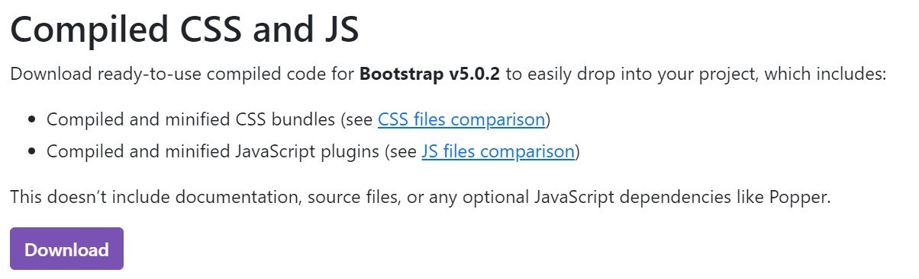
Before getting started
CSS(CDN)
JAVA(CDN)
<link href="https://cdn.jsdelivr.net/npm/bootstrap@5.0.2
/dist/css/bootstrap.min.css" rel="stylesheet" integrity="sha384- EVSTQN3/azprG1Anm3QDgpJLIm9Nao0Yz1ztcQTw Fspd3yD65VohhpuuCOmLASjC" crossorigin="anonymous">
<script src="https://cdn.jsdelivr.net/npm/bootstrap@5.0.2/ dist/js/bootstrap.bundle.min.js" integrity="sha384- MrcW6ZMFYlzcLA8Nl+NtUVF0sA7MsXsP1UyJoMp 4YLEuNSfAP+JcXn/tWtIaxVXM" crossorigin="anonymous"></script>
Downloadables

Slide 4




How it works
<nav class="navbar">
Navbars require a wrapping
.navbar with .navbar- expand{-sm|-md|-lg|-xl|- xxl} for responsive collapsing and color
scheme classes.
Ensure
accessibility
Navbars are responsive by default, but you can easily modify them to change that.
Responsive behavior depends on our Collapse JavaScript plugin.
by using a <nav> element or, if using a more generic element such as a <div>, add a role="navigation" to
-sm: 576px ,md: 768px , lg: 992px , xl: 1200px , xxl 1400px
every navbar to explicitly identify it as a landmark region for users of assistive technologies.

Slide 5
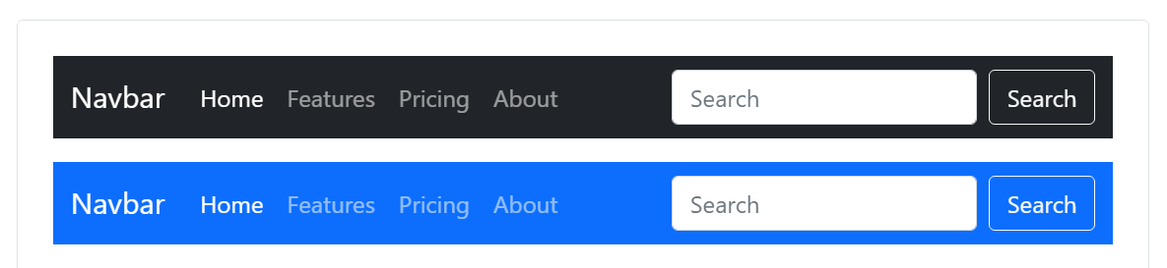
<nav class="navbar navbar-expand-lg navbar-dark bg-dark">
....
</nav>
<nav class="navbar navbar-expand-lg navbar-dark bg-blue">
....
</nav>

Slide 6

Supported Content
<nav class="..">
</nav>
.navbar-brand
.navbar-text
.navbar-nav
.collapse.navbar-collapse
.navbar-toggler
.navbar-scroll

Slide 7
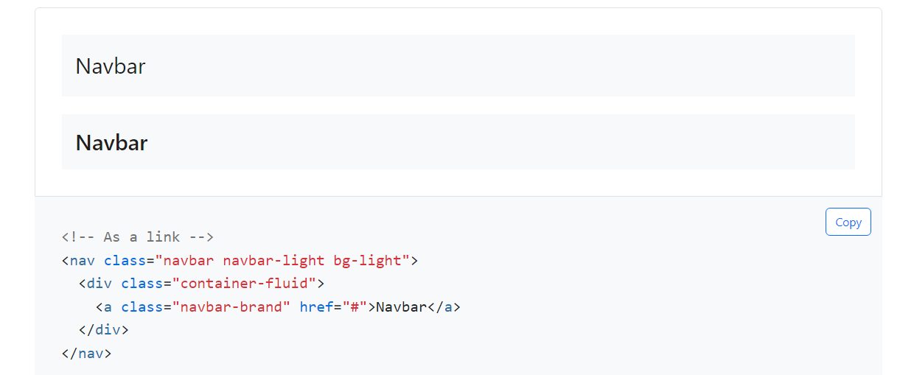
NavBar Brand

Slide 8
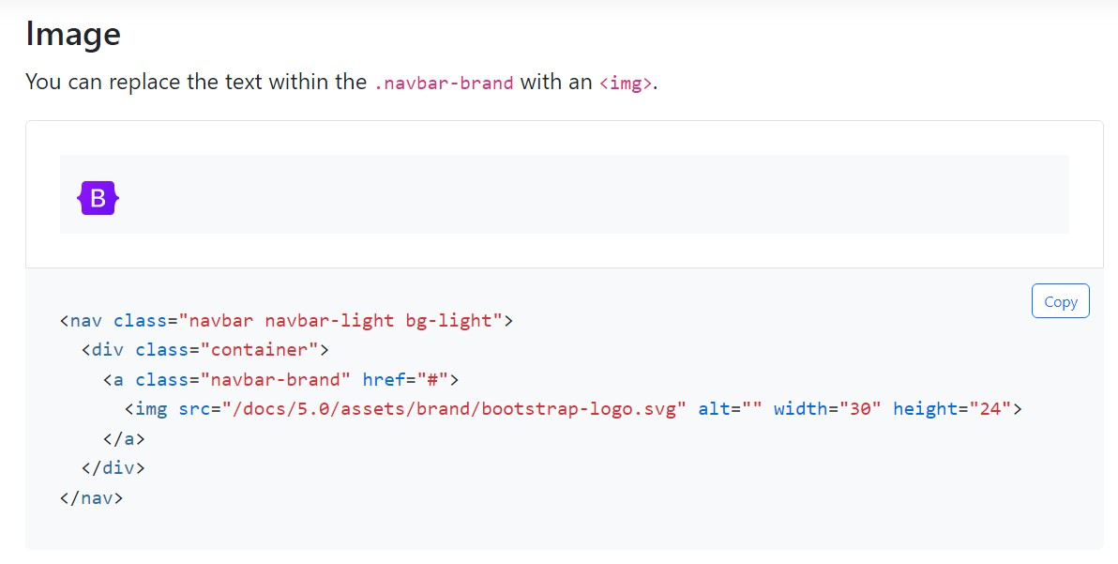
NavBar Image

Slide 9

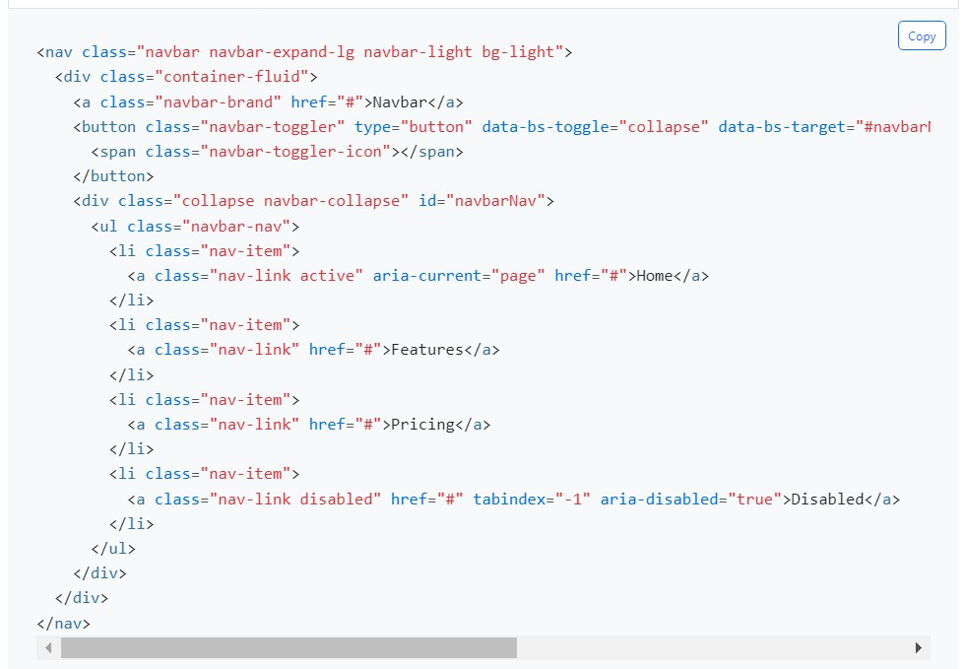
NavBar Nav

Slide 10
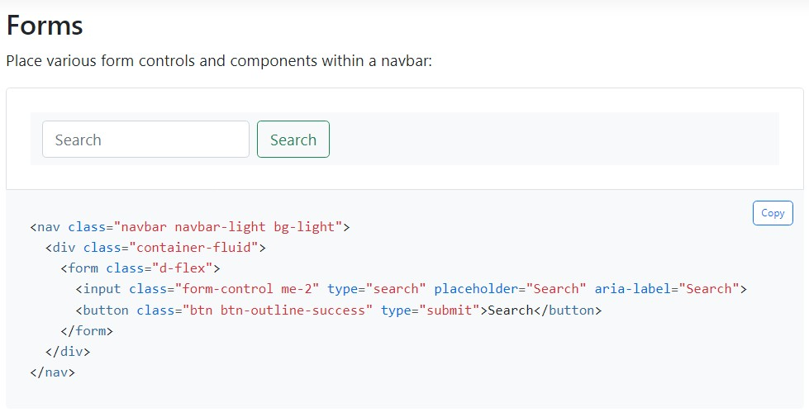
NavBar Forms

Slide 11


Placement
Default Fixed Top
Fixed Bottom Sticky Top
<nav class="navbar fixed-top navbar-light bg-light">

Slide 12
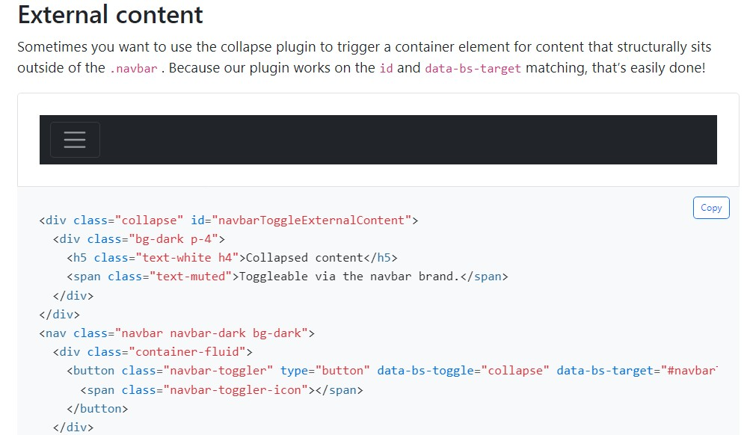

Slide 13

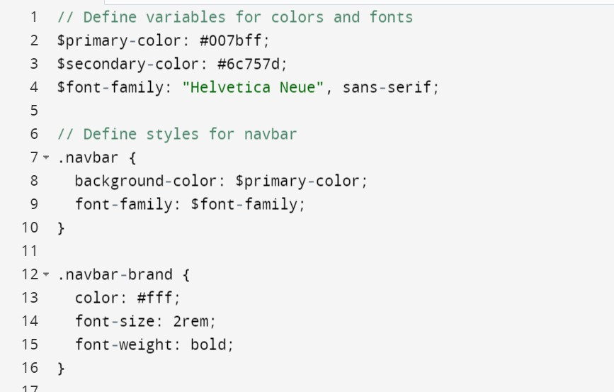


Variables
Usage
Sass(.scss)

Slide 14
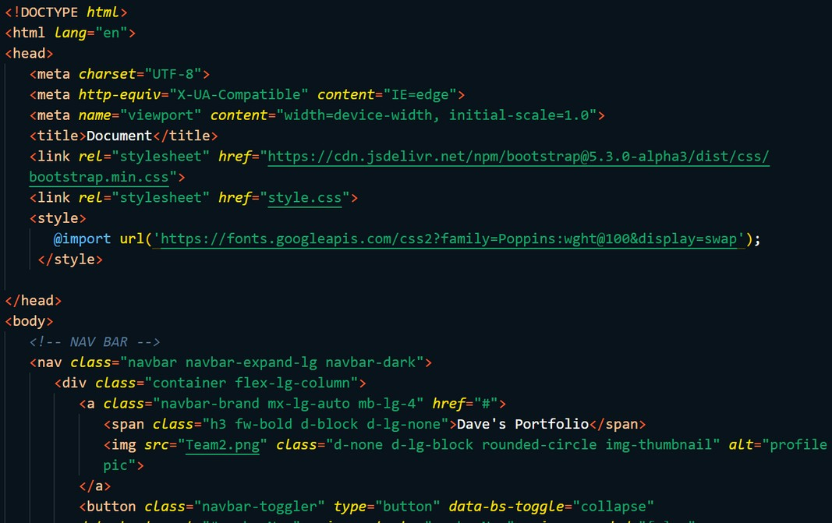
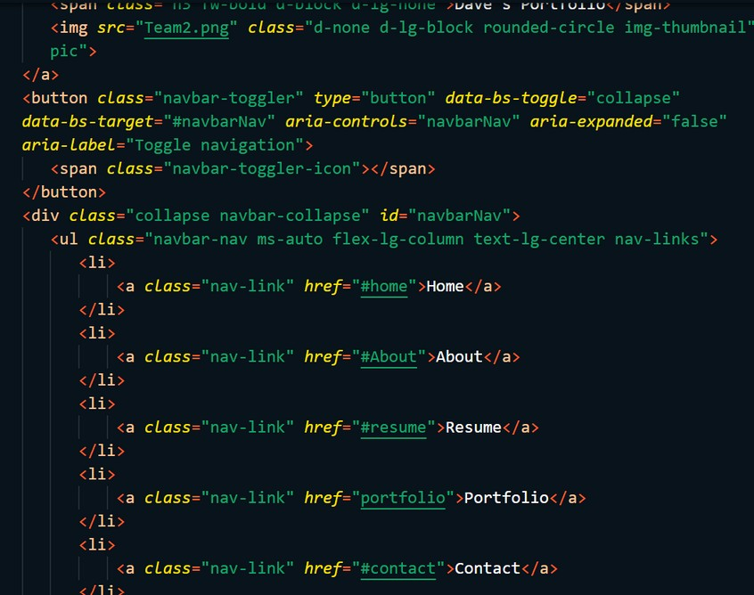
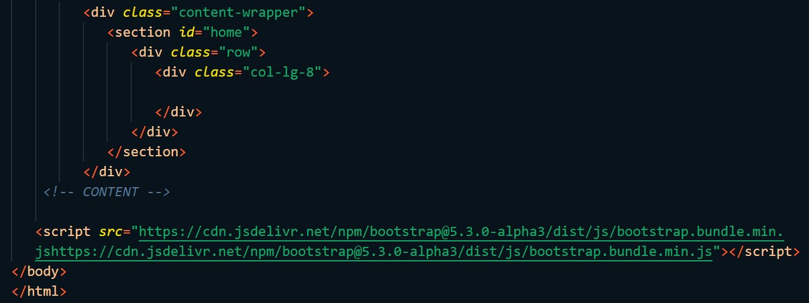
Sample Source Code

Slide 15

Sample View:

Slide 16

Thank You

